Slide 1
Being agile with modern Java

Slide 2
Being agile?

Slide 3
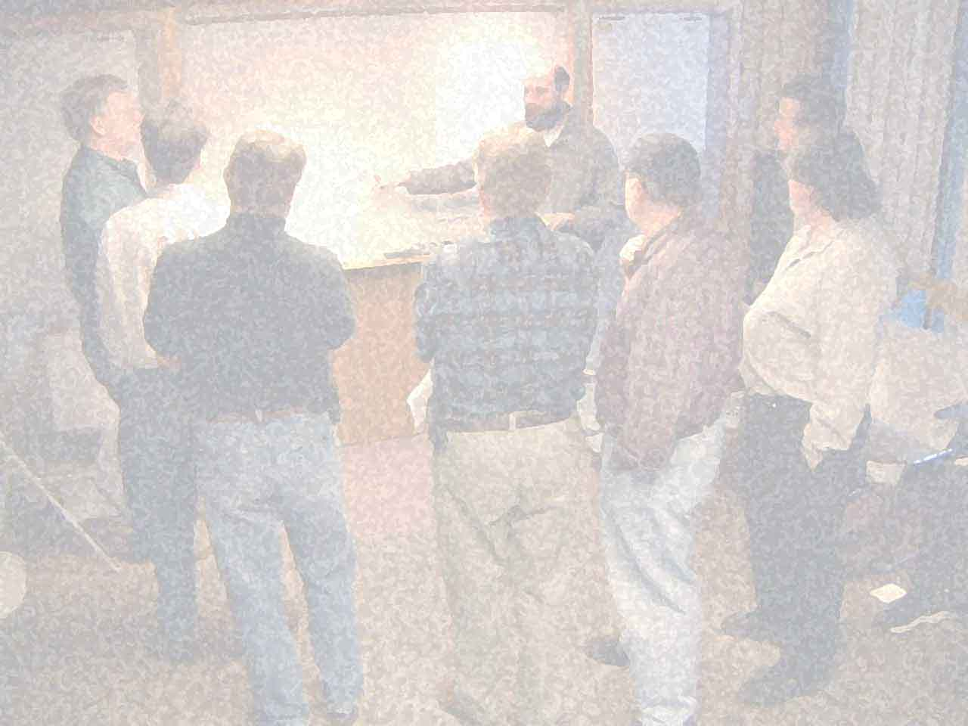

Slide 4
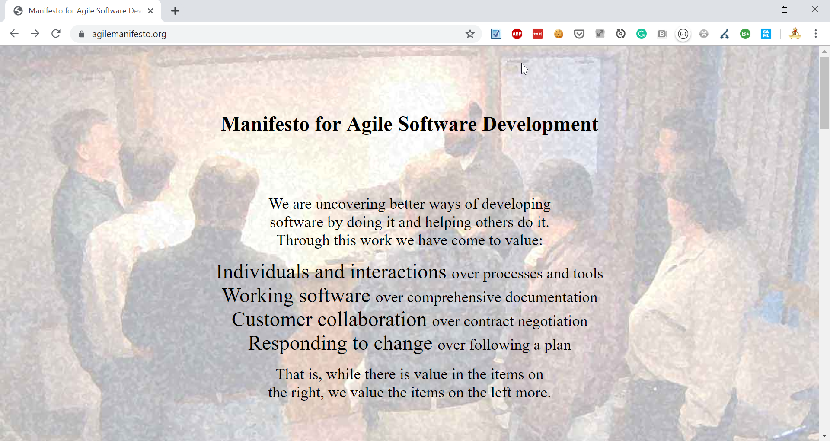
Notes:
JOKE: Old school HTML

Slide 5






(… at that time)
PROBLEMS

Slide 6
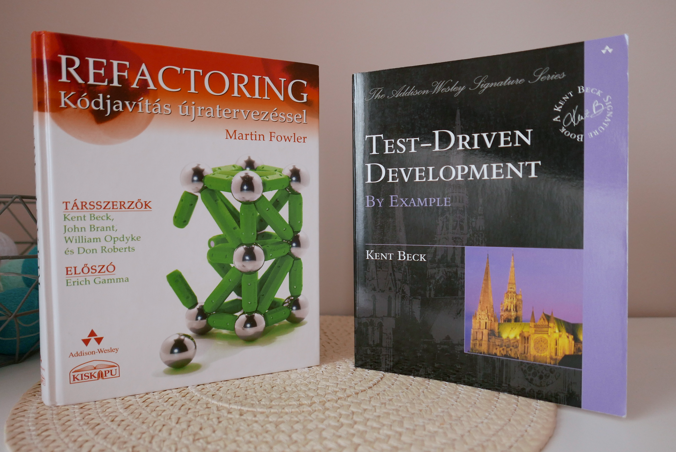

Slide 7
Being agile?

Slide 8
Thinking agile?

Slide 9
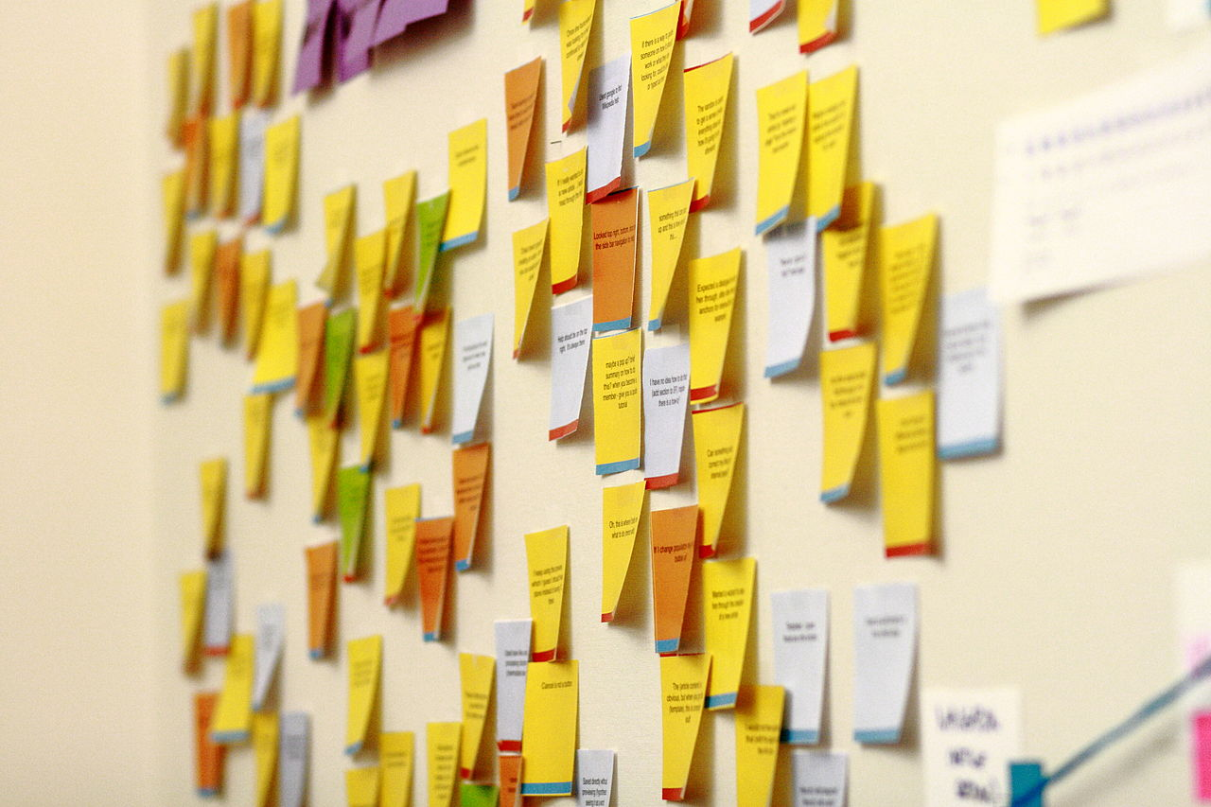

Slide 10
continuous optimization
simplification
small iterations
small experiments
AGILE
baby steps
stabilization
Notes:
EXAMPLE: Refactoring & TDD are using these approaches

Slide 11
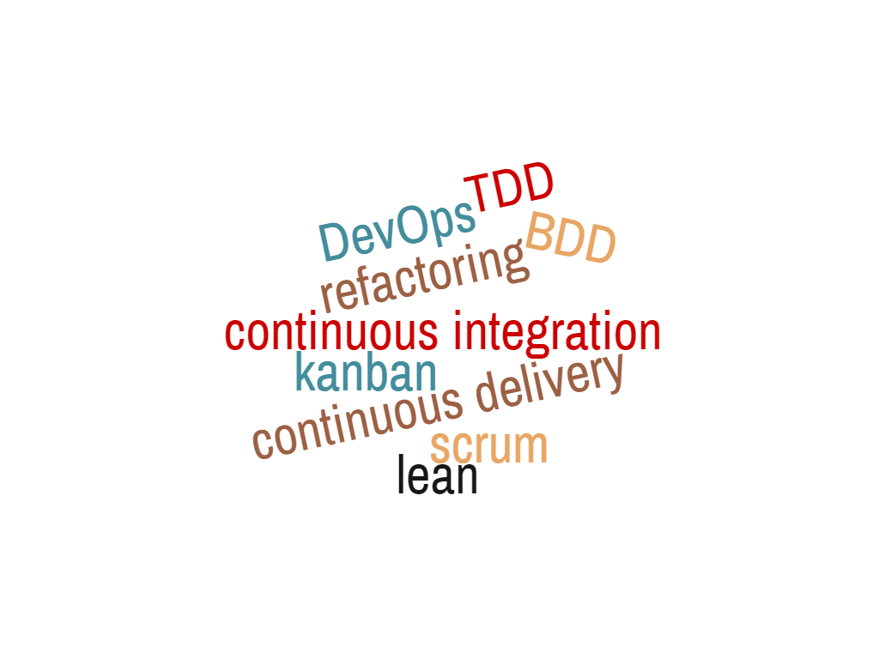
SAME APPROACH
Notes:
Example – how you can improve slow deployments
Word Cloud:
1 continuous~integration
1 continuous~delivery
1 refactoring
1 kanban
1 DevOps
1 scrum
1 lean
1 TDD
1 BDD

Slide 12
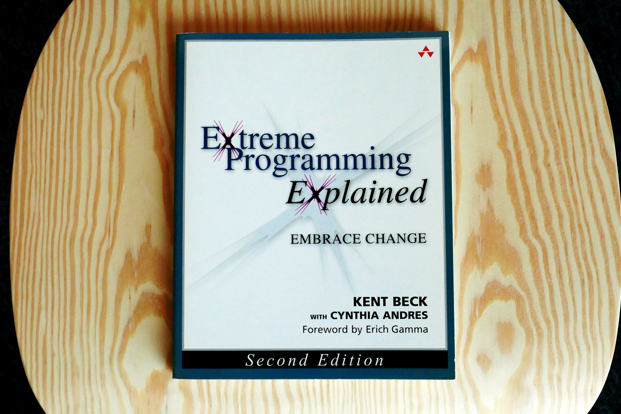

Slide 13
CI

Slide 14
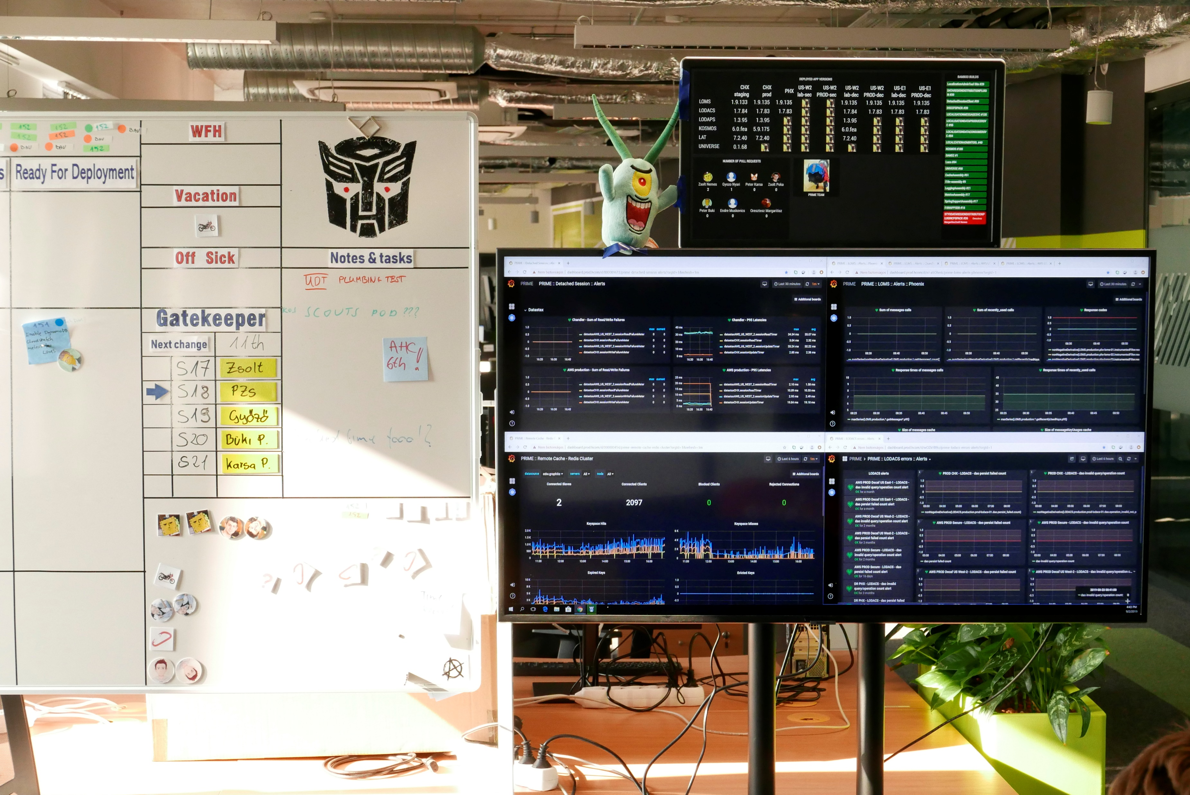
CI

Slide 15
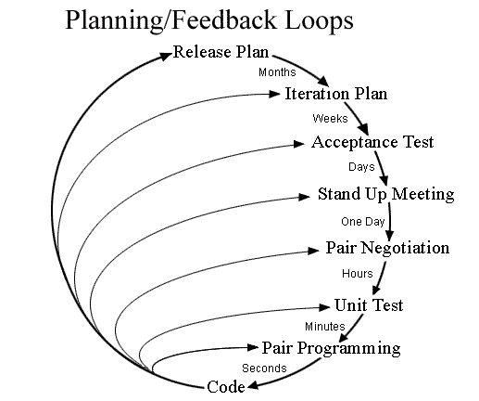
Notes:
Switch to faster feedback, when doubts: pairing

Slide 16
pipeline as code
living documentation
continuous testing
generators
containers
hotswap
code

Slide 17
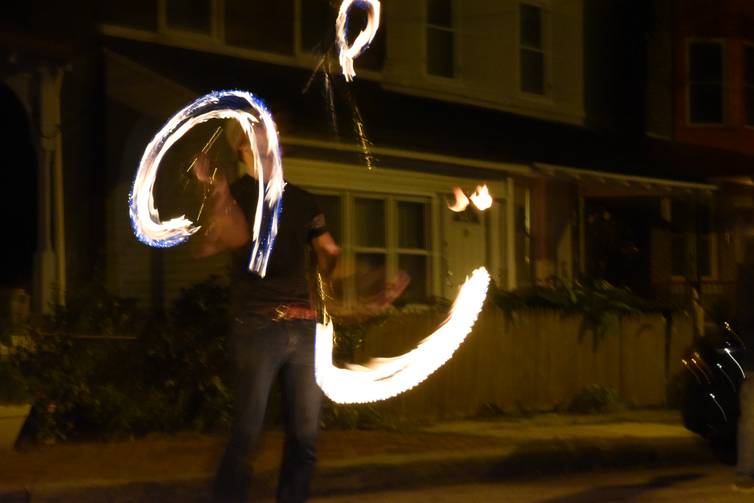
HOTSWAP

Slide 18
Ctrl+F9
Notes:
Works with Node.JS, Angular, Spring Boot, Play FW, Jhipster

Slide 19

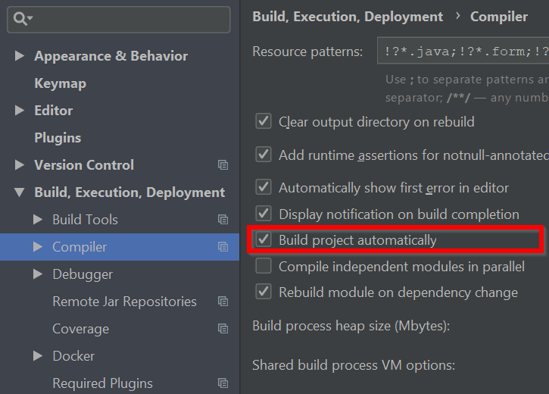
Notes:
Agile: simplification, small experiments, continuous optimization, baby steps
Metrics: fast feedback, usability, simplicity

Slide 20
0 cost
1st thing to do
don’t block hotswap
hotswap the whole day

Slide 21

CONTAINERS

Slide 22
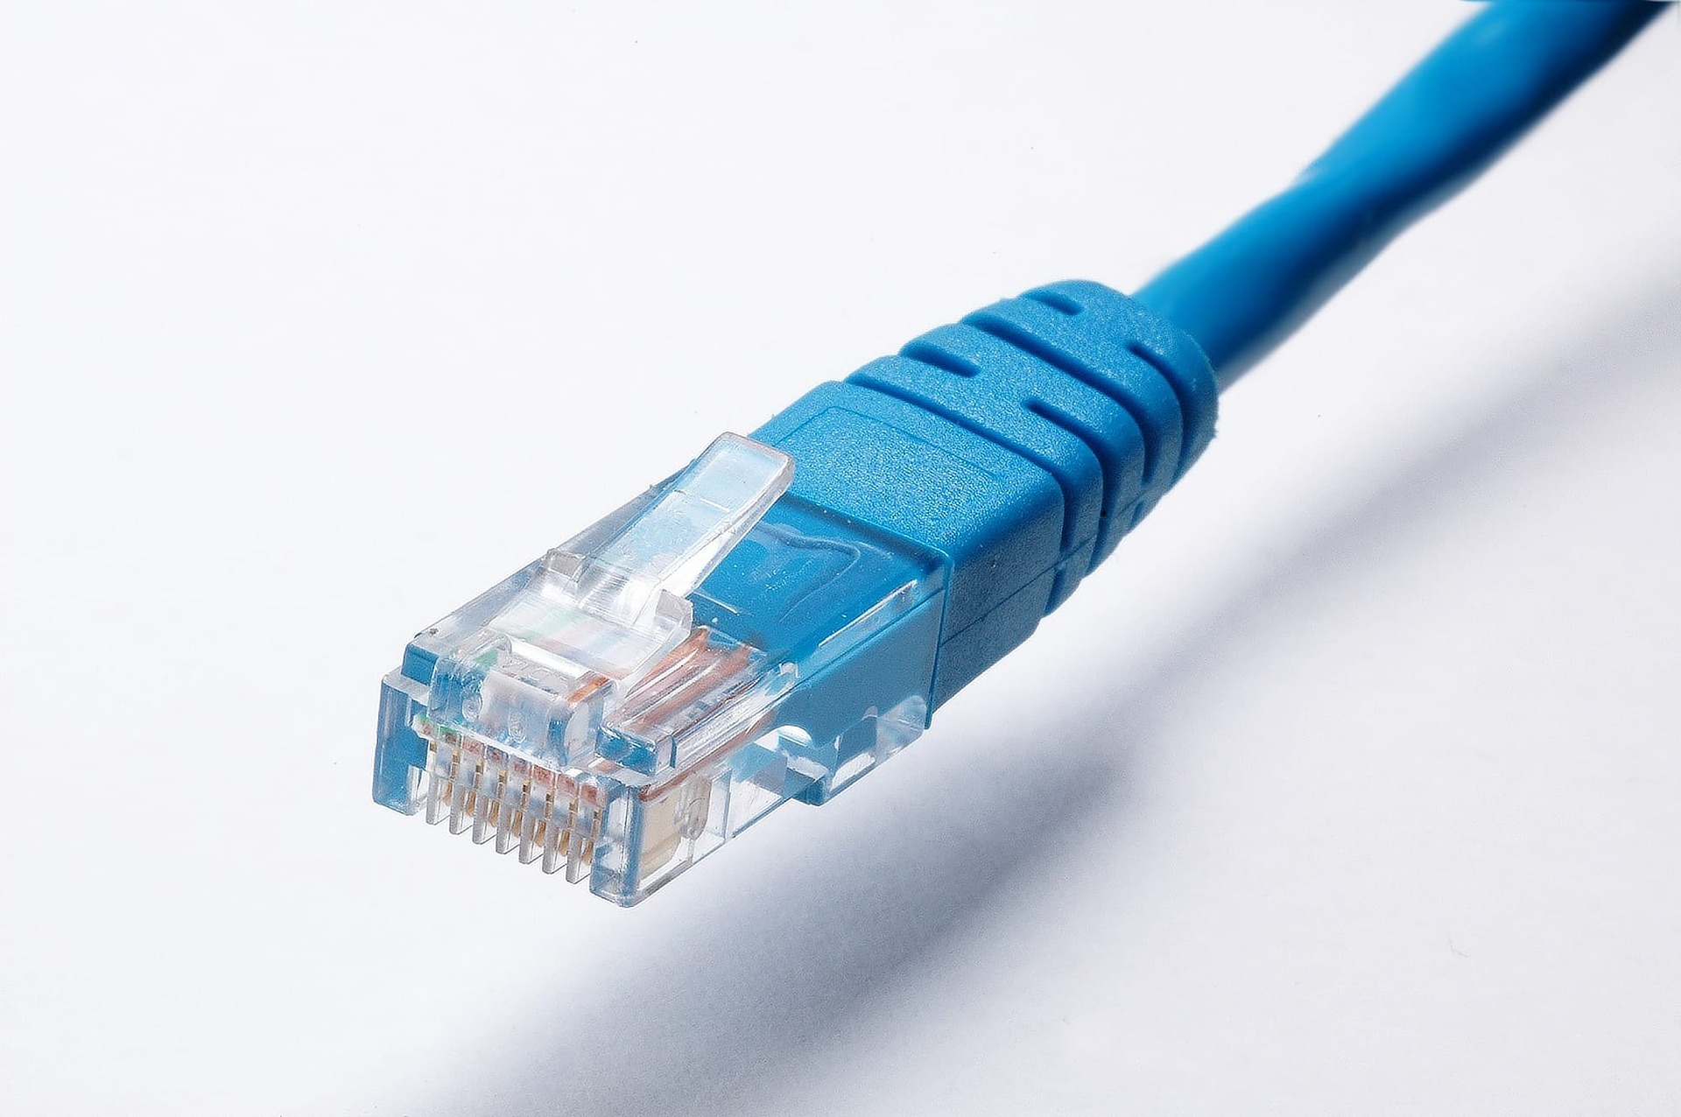

Slide 23








SAML 2.0
S3

Slide 24


VS
Notes:
3 seconds and 30 seconds make a difference

Slide 25
apiVersion: apps/v1
kind: Deployment
…
spec:
…
template:
spec:
containers:
- name: …
…
---
apiVersion: v1
kind: Service
metadata:
name: mysql
…
version: '3'
services:
toxiproxy:
image: "shopify/toxiproxy"
redis-master:
image: "redis:alpine"
redis-slave:
image: "redis:alpine"
mysql:
image: mysql:5.6
…

Slide 26



Slide 27

plugins { id 'com.google.cloud.tools.jib' version '1.4.0’ }
./gradlew jibDockerBuild \
--image=agile-springboot:latest

Slide 28
apiVersion: skaffold/v1beta13 kind: Config build: artifacts: - image: agile-springboot deploy: kubectl: manifests: - src\main\kubernetes\agile-springboot.yml - src\main\kubernetes\mysql.yml
eval $(minikube env)
skaffold init
skaffold dev
Notes:
Agile: simplification, small iterations, small experiments, stabilization
Metrics: no snowflakes, no S.P.O.F, usability, fast feedback, simplicity

Slide 29
fastest orchestrator locally
use embedded dependencies if needed
don’t depend on your orchestrator
dependencies living documentation
don’t block hotswappin’

Slide 30
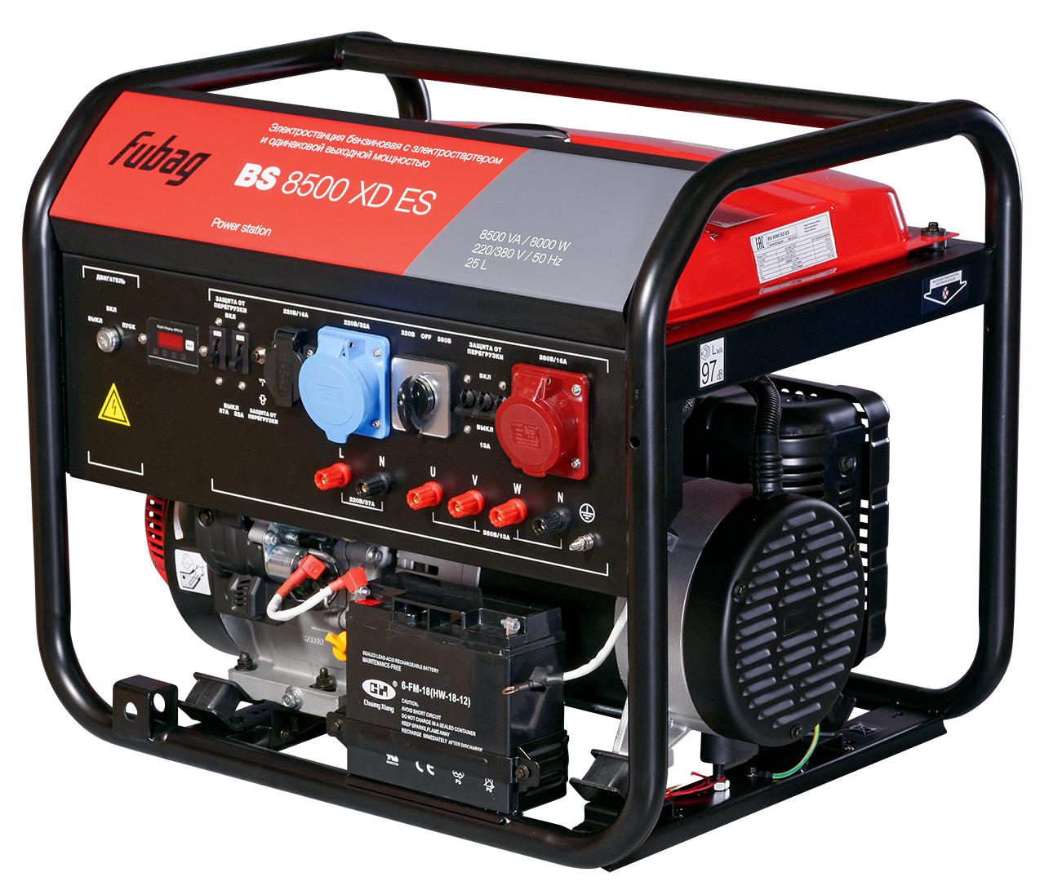
GENERATORS

Slide 31
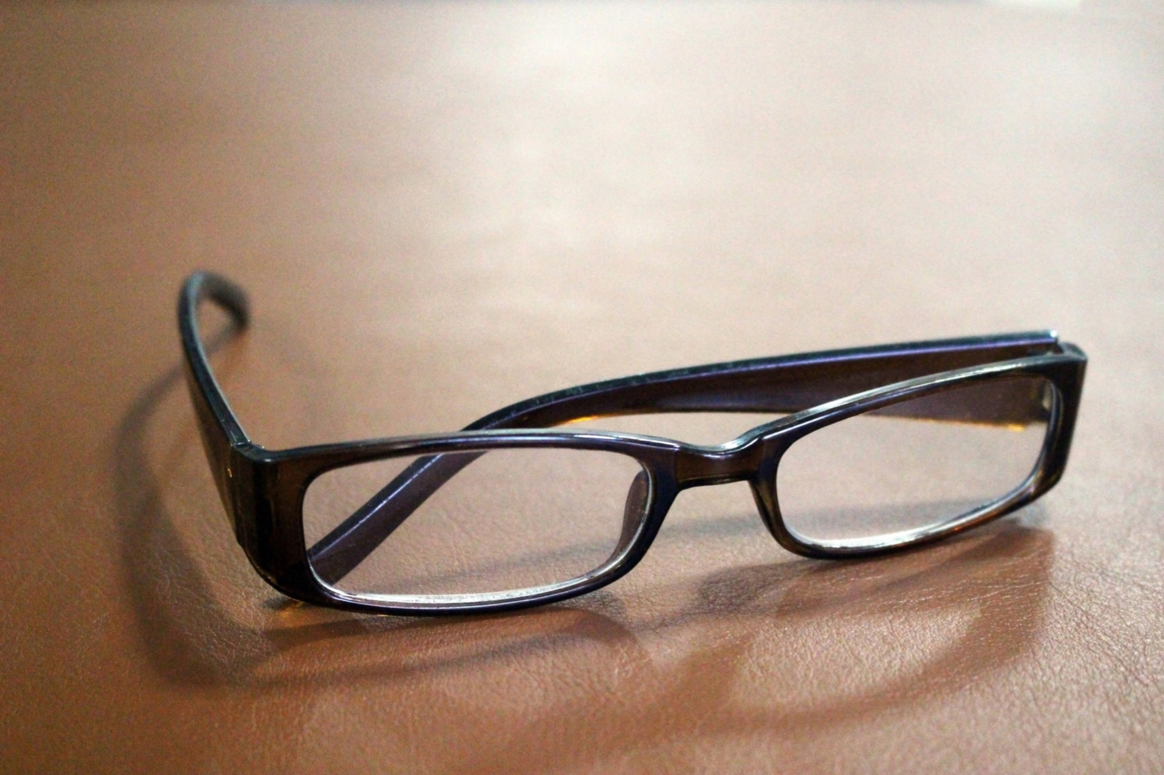
CODE READING

Slide 32
CODE
=
DOMAIN

Slide 33



lombok

Slide 34
@Data @Entity public class Person { @Id private Integer id; private String firstName; private String lastName; }
@NoArgsConstructor public class LegacyPersonDTO { @Getter @Setter private String fullName; }

Slide 35
@Mapper public interface PersonToPersonDTOMapper { @Mapping(target = "fullName", expression =
"java(person.getFirstName()+\" \"+person.getLastName())") LegacyPersonDTO personToLegacyPersonDTO(Person person);
}

Slide 36
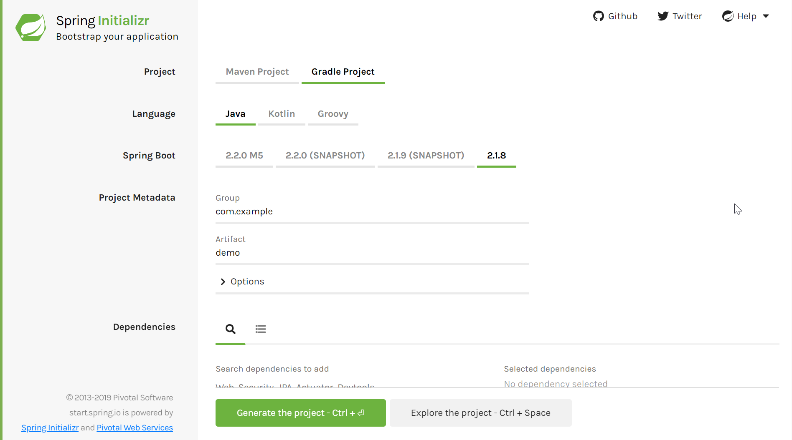

Slide 37
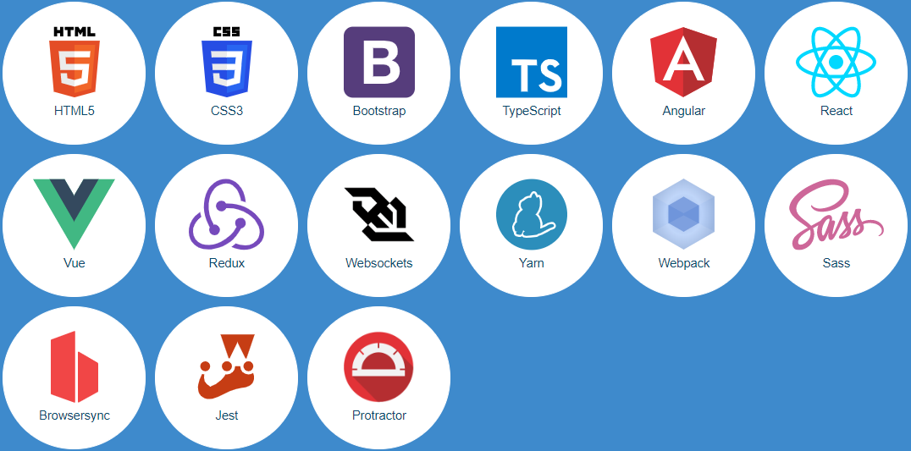
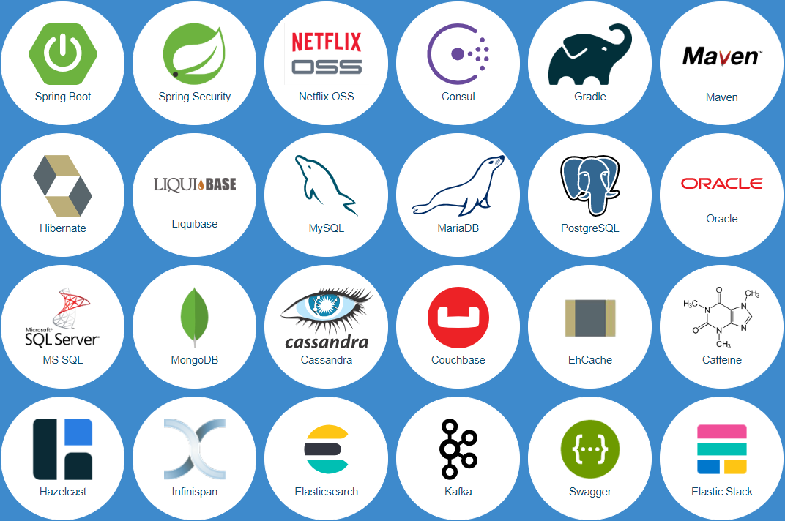

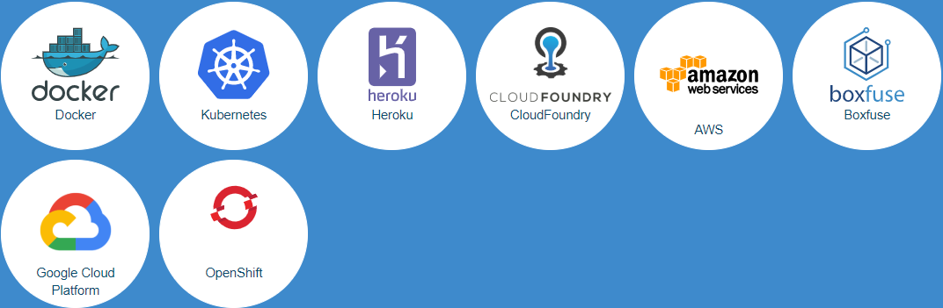
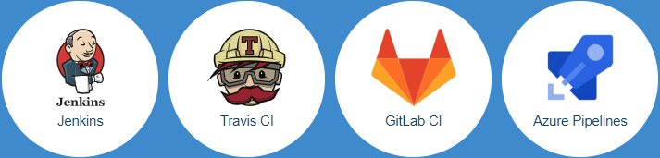

Slide 38
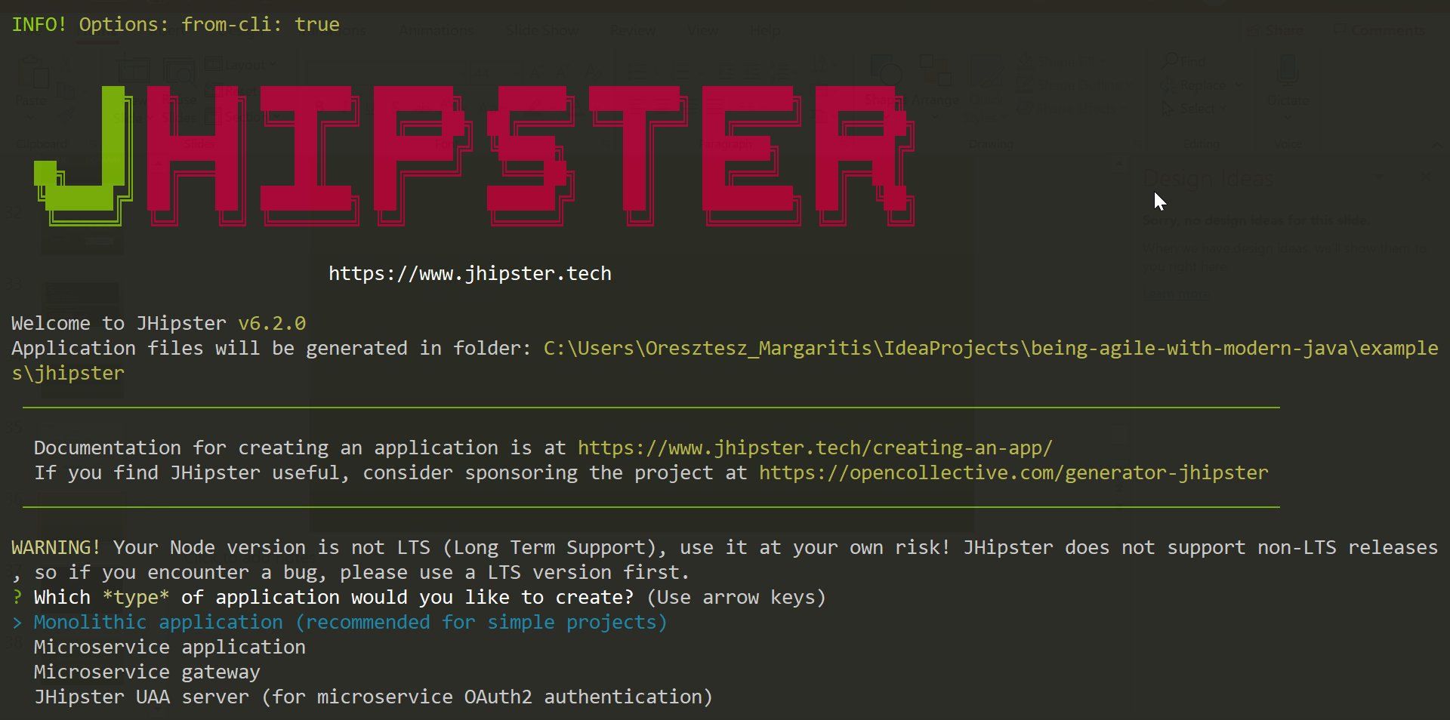

Slide 39
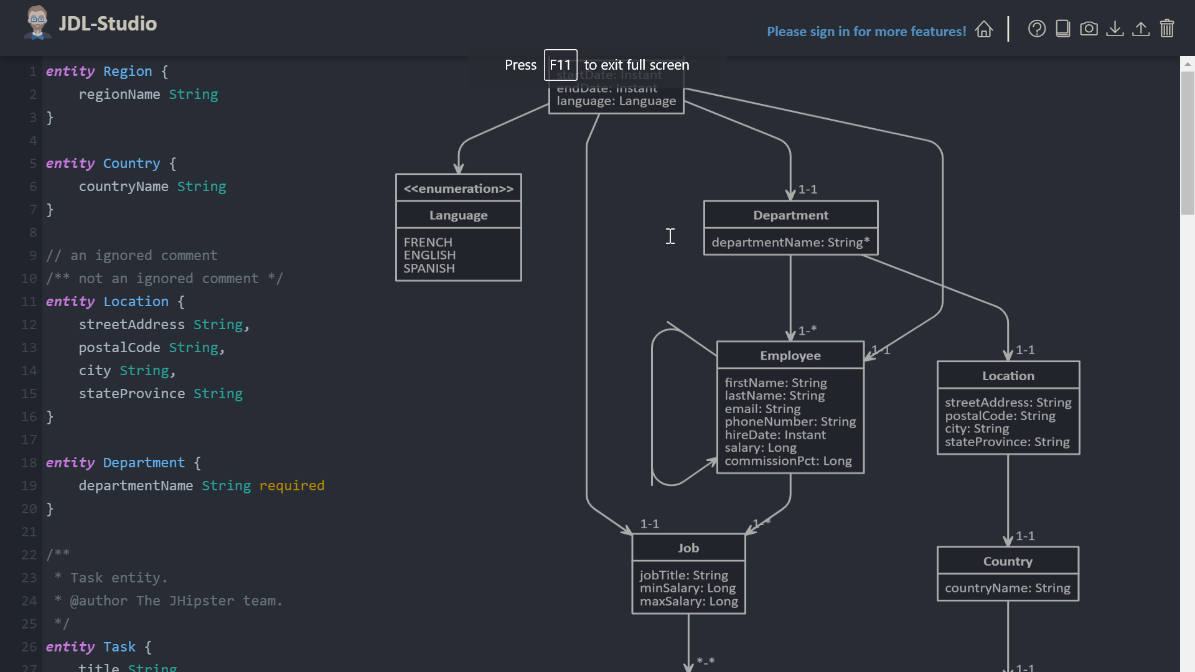
Notes:
Agile: simplification, small experiments, small iterations, baby steps
Metrics: simplicity, feature richness, usability

Slide 40
read less, write more
application runs from day 1
avoid stuck in re-generating everything

Slide 41

CONTINUOUS TESTING

Slide 42
MANUAL
END-TO-END
INTEGRATION
UNIT

Slide 43
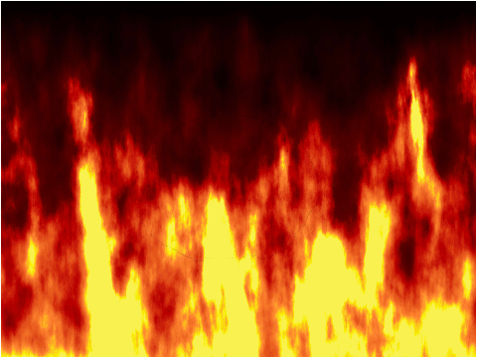

MANUAL
INTEGRATION
UNIT
END-TO-END
DEV
QA

Slide 44


Mocha
Grinder
Selenium
JUnit
PyTest
Gatling
JMeter

Slide 45
@Test public void testGetPerson() throws IOException, InterruptedException { var getPersonRequest = HttpRequest.newBuilder() .uri(URI.create("http://localhost:8080/person/1")) .timeout(Duration.ofSeconds(10)) .header("Content-Type", "application/json") .build(); var getPersonResponse = HTTP_CLIENT.send(getPersonRequest, AS_STRING); Assert.assertEquals(200, getPersonResponse.statusCode()); Assert.assertTrue(getPersonResponse.body().contains("firstName")); Assert.assertTrue(getPersonResponse.body().contains("lastName")); }

Slide 46
--- execution: - executor: junit concurrency: 20 hold-for: 2m scenario: script: src/test/java reporting: - module: final-stats - module: console - module: passfail criteria: - avg-rt of testGetPerson>50ms for 10s, stop as failed - p99 of testGetPerson>120ms for 5s, stop as failed - fail of testGetLegacyPerson>50% for 10s, stop as failed modules: junit: compile-target-java: 11

Slide 47
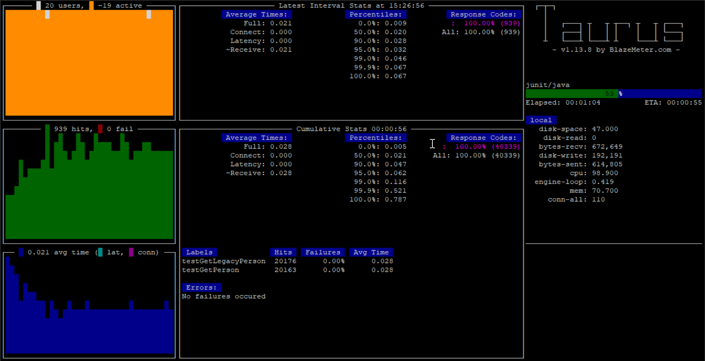
Notes:
Agile: simplification, stabilization, continuous optimization, small iterations, small experiments
Metrics: simplicity, fast feedback, usability, feature richness, no snowflakes

Slide 48
same review for all tests
use common language
re-use test cases
cheap high-level tests

Slide 49

LIVING DOCUMENTATION

Slide 50
/** * Feature that determines whether generator will automatically * close underlying output target that is NOT owned by the * generator. * If disabled, calling application has to separately * close the underlying {@link OutputStream} and {@link Writer} * instances used to create the generator. If enabled, generator * will handle closing, as long as generator itself gets closed: * this happens when end-of-input is encountered, or generator * is closed by a call to {@link JsonGenerator#close}. *<p> * Feature is enabled by default. */ AUTO_CLOSE_TARGET(true),

Slide 51
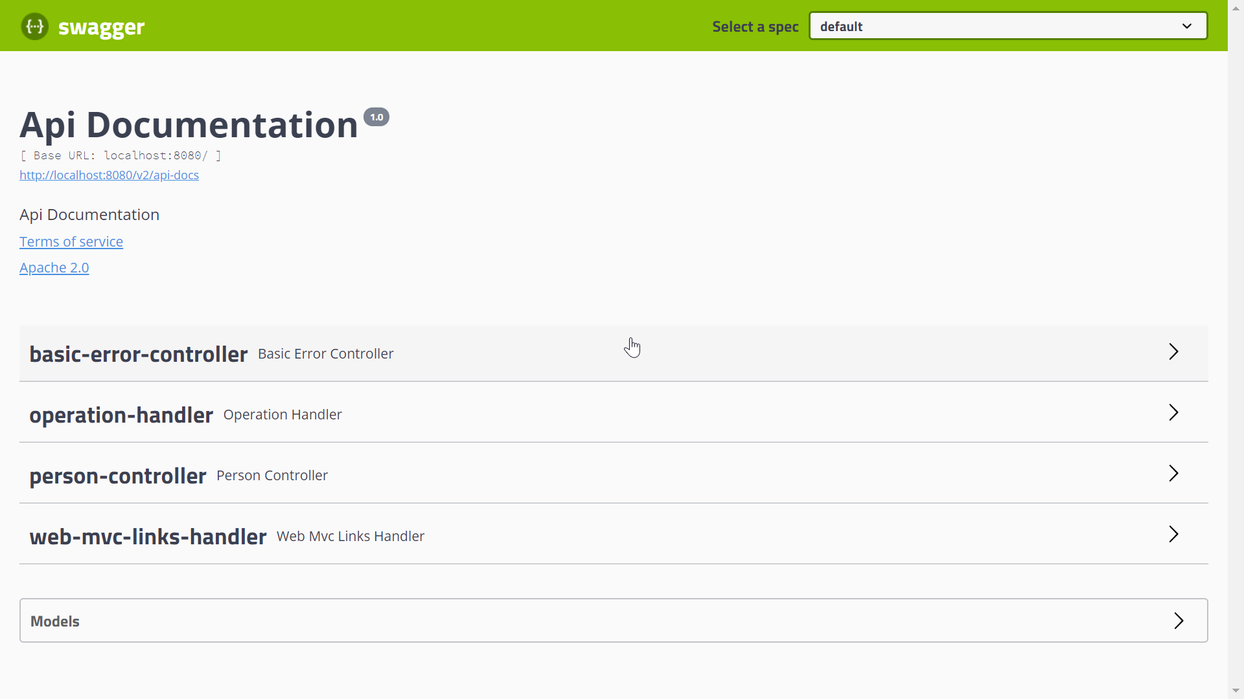

Slide 52



REST
Cucumber
REST
Toxiproxy

Slide 53
Feature: Storage availability scenarios for user service … Background: … Scenario: Read-only mode without MySQL Given 'MySQL' is down When user 'u-12345abde234' is requested Then the user with id 'u-12345abde234' is returned from 'Redis'
Notes:
Agile: simplification
Metrics: simplicity, fast feedback, usability, feature richness

Slide 54
minimize traditional documentation
BDD is not just for e2e tests
“better design” over any documentation

Slide 55

AS CODE
PIPELINE

Slide 56
pipeline { ... stages { stage('checkout') { steps { sh '...' } } stage('test') { steps { ... } } } }

Slide 57
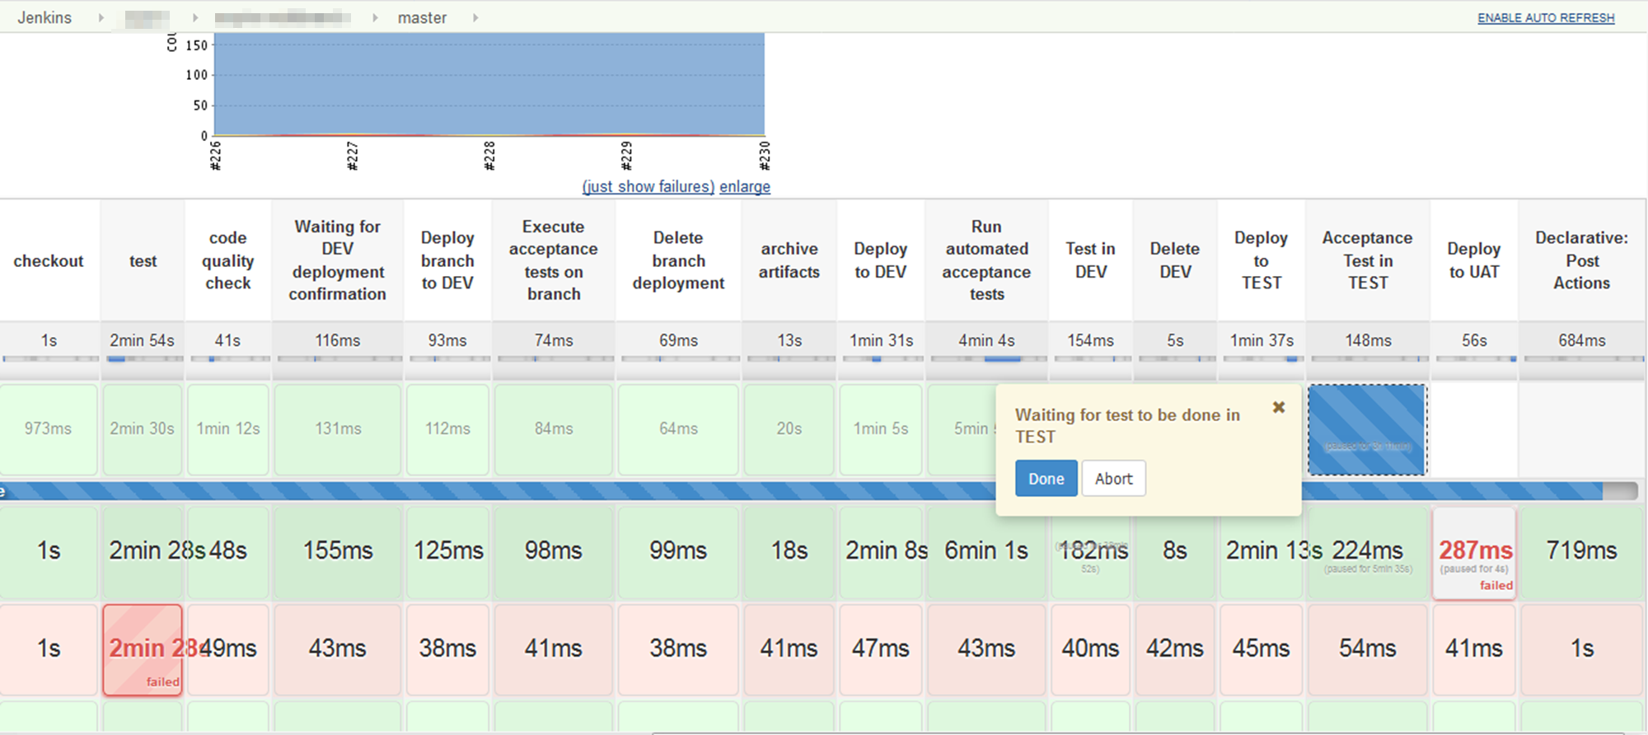
Notes:
Agile: continuous optimization, simplification, small iterations, small experiments, stabilization, baby steps
Metrics: no snowflakes, no S.P.O.F, feature richness, usability, fast feedback, simplicity

Slide 58
feature branches branch deploys
minimize CI/CD complexity !!!
keep pipelines version-controlled

Slide 59


continuous testing
pipeline as code
containers
living documentation
generators
hotswap

Slide 60
principles
practices
tools

Slide 61
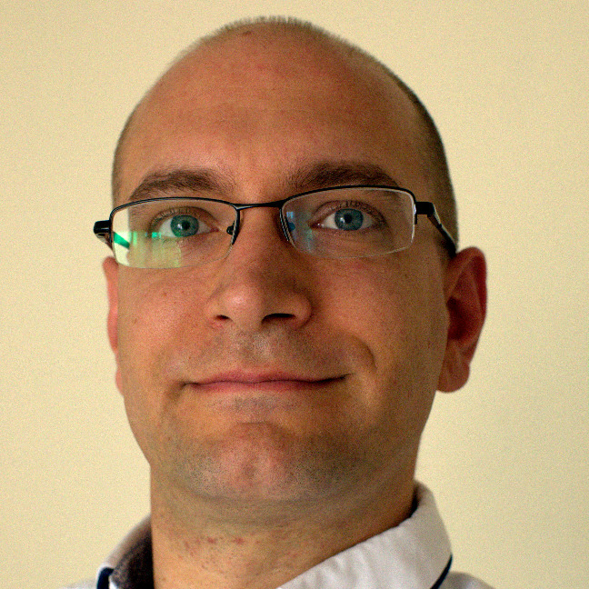




Thank you!
Oresztész Margaritisz
@gitaroktato
gitaroktato
oresztesz_margaritisz@epam.com
https://www.linkedin.com/in/oresztesz

